Slide 1
Residential Construction Costs Breakdown Per Square Foot

Slide 2

01
Foundation: $5 - $10 per sq. ft.
02
Framing: $20 - $40 per sq. ft.
Cost Categories Overview
03
Plumbing & Electrical: $15 - $30 per sq. ft.
04
Roofing: $5 - $15 per sq. ft.
05
Interior Finishes: $25 - $50 per sq. ft.

Slide 3
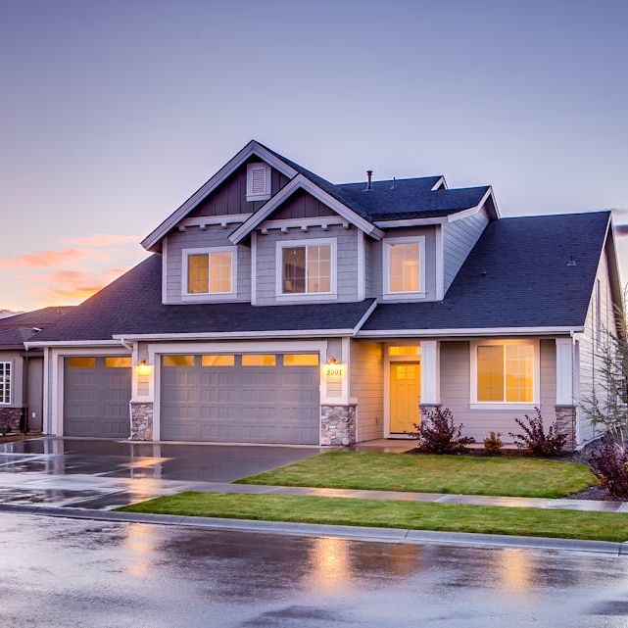
Foundation Costs
Consistent Costs
Foundation costs typically range between $5 and $10 per sq. ft. Variations depend on the complexity of the foundation, such as basements or frost-resistant slabs.
Key Insights
Complex foundations for colder climates may increase costs significantly. Always conduct soil testing to avoid expensive adjustments.
Example Tip
A home in Michigan used frost-resistant slabs, adding $2,000 to the cost but preventing future repairs.

Slide 4
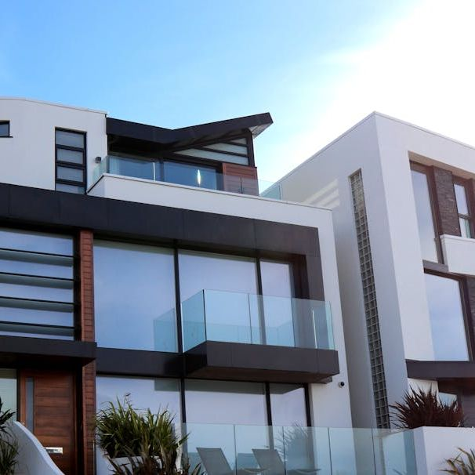
Framing Costs
Variable Costs
Framing costs can range from $20 to $40 per sq. ft., influenced heavily by lumber prices and structural complexity.
Key Example
During the 2021 lumber price surge, framing costs doubled, creating budgeting challenges for many homeowners.
Tip for Savings
Monitor market prices for lumber and explore alternative materials to mitigate price fluctuations.

Slide 5
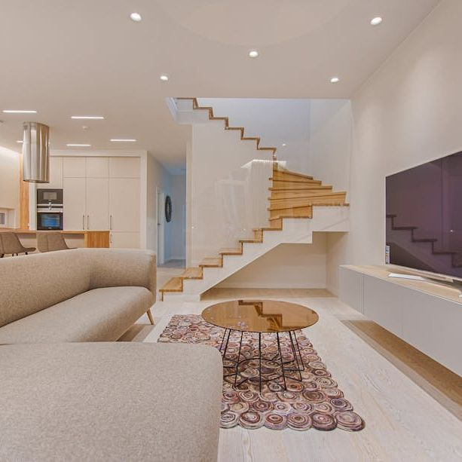
Interior Finishes
Diverse Costs
Interior finishes vary widely, ranging from $25 to $50 per sq. ft. depending on material choices and labor quality.
High Cost Drivers
Premium finishes like hardwood flooring or custom cabinetry can drive costs higher than expected.
Savings Strategy
Opt for mid-range materials like engineered wood flooring or stock cabinetry to balance quality and budget.

Slide 6
Key Insights & Lessons Learned
Foundation Tips
Budgeting Insights
Cost-Saving Tips
Soil testing upfront prevents costly adjustments. Frost-resistant slabs can save long-term repair costs.
Allocate a contingency fund to handle unexpected price surges like those seen in lumber costs.
Opt for mid-range materials for finishes to cut costs without compromising quality.

